Slide 1
4-bit Weight-Only Quantization & Beyond
AHS Workshop 02/14/2024

Slide 2
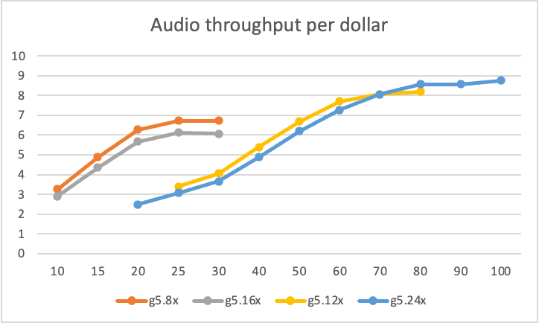
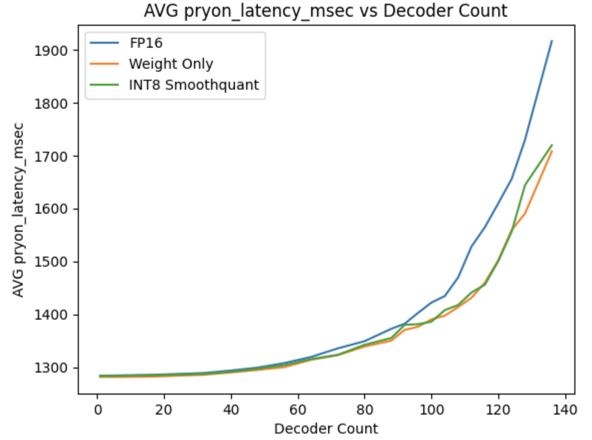
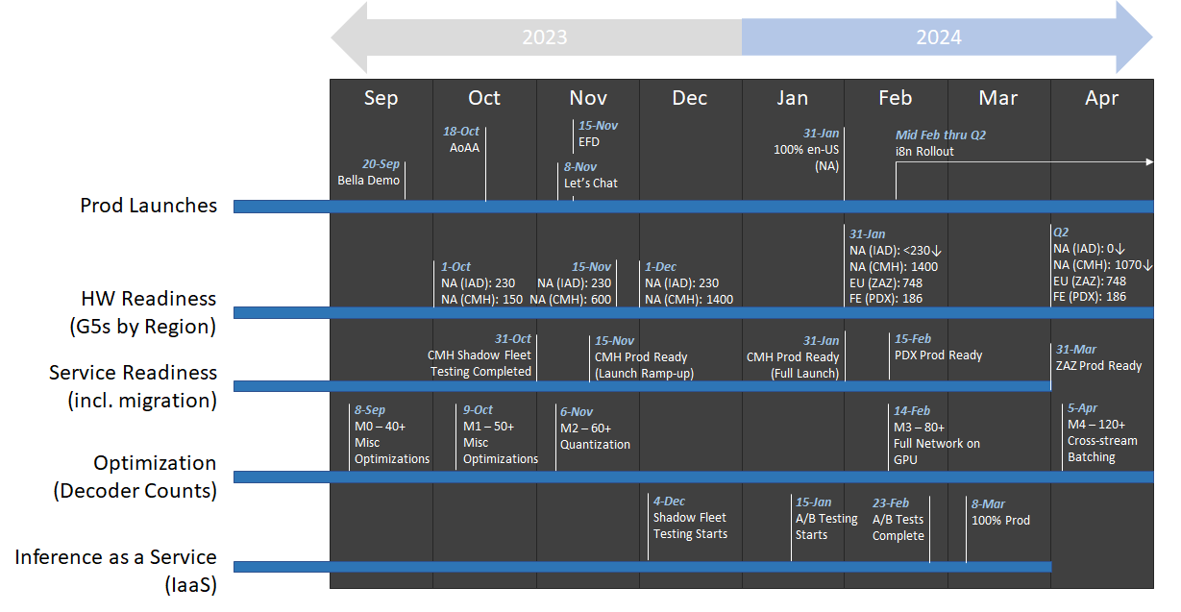
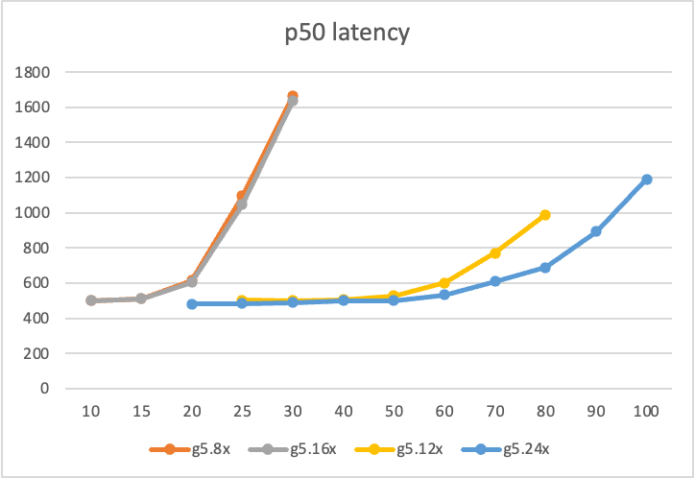
Towards cost-parity
100M -> 1B -> 2B -> 7B -> …

Slide 3
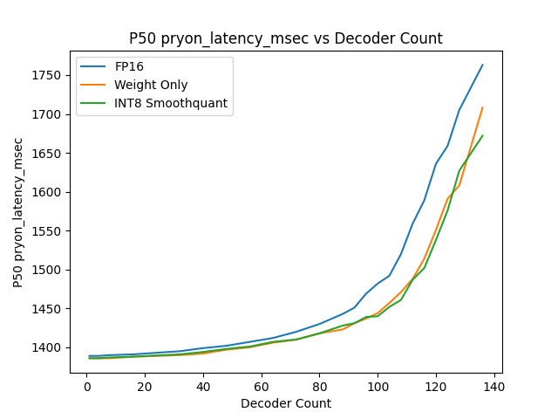
CPU bound

Slide 4
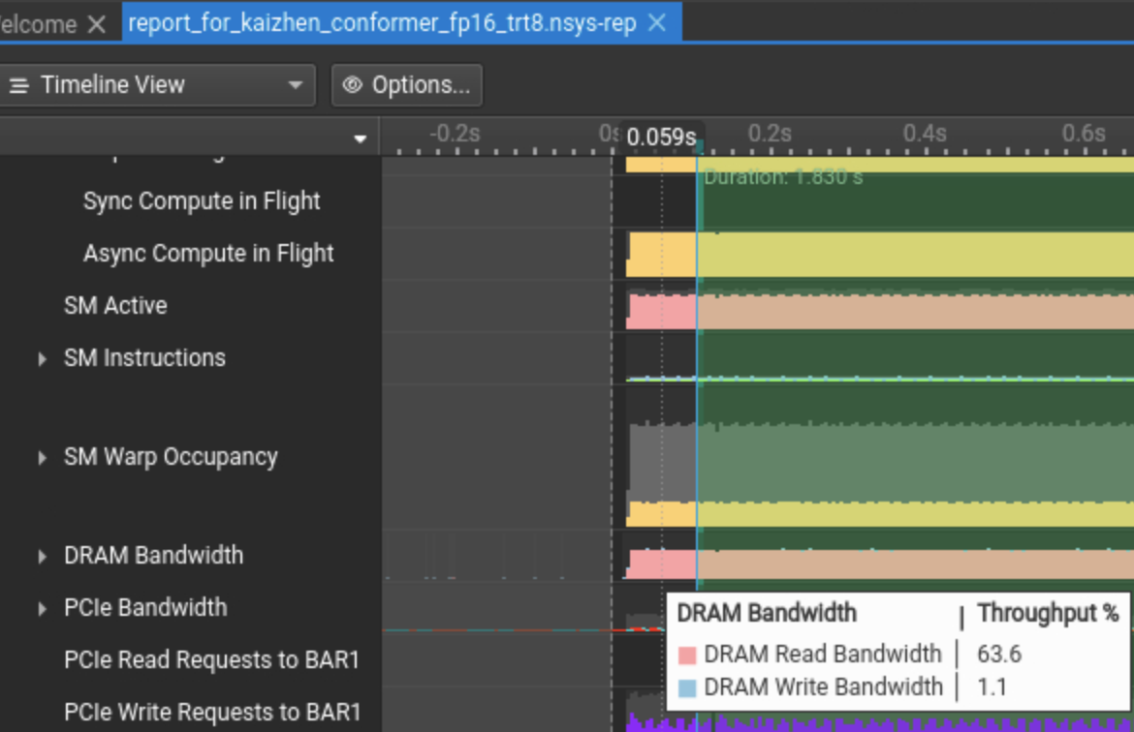
Memory bound v.s. Compute bound

Slide 5
Why’s 4-bit WoQ important?
Solve the encoder bound issue -> more decoder count -> higher throughput
Without sacrificing latency as much

Slide 6
Some pre-mature takeaways
Large ASR is currently CPU bound. Compressing models won’t push the needle much at this time.
Move FFR-Enc and Decoder to GPU
Shift towards a more powerful GPU
To be addressed in about 3 months…
Large Conformer is memory bound. Activation quantization won’t help much.
Going from 4-bit to 2-bit, it may be compute bound.

Slide 7
Neural efficiency tools
Structures
Scheduler
Compression utilities
Hyperparameter configs
Readiness
Phasa
PyRama

Slide 8
Neural efficiency tools
Structures
Scheduler
Compression utilities
Hyperparameter configs
Readiness
Phasa
PyRama

Slide 9
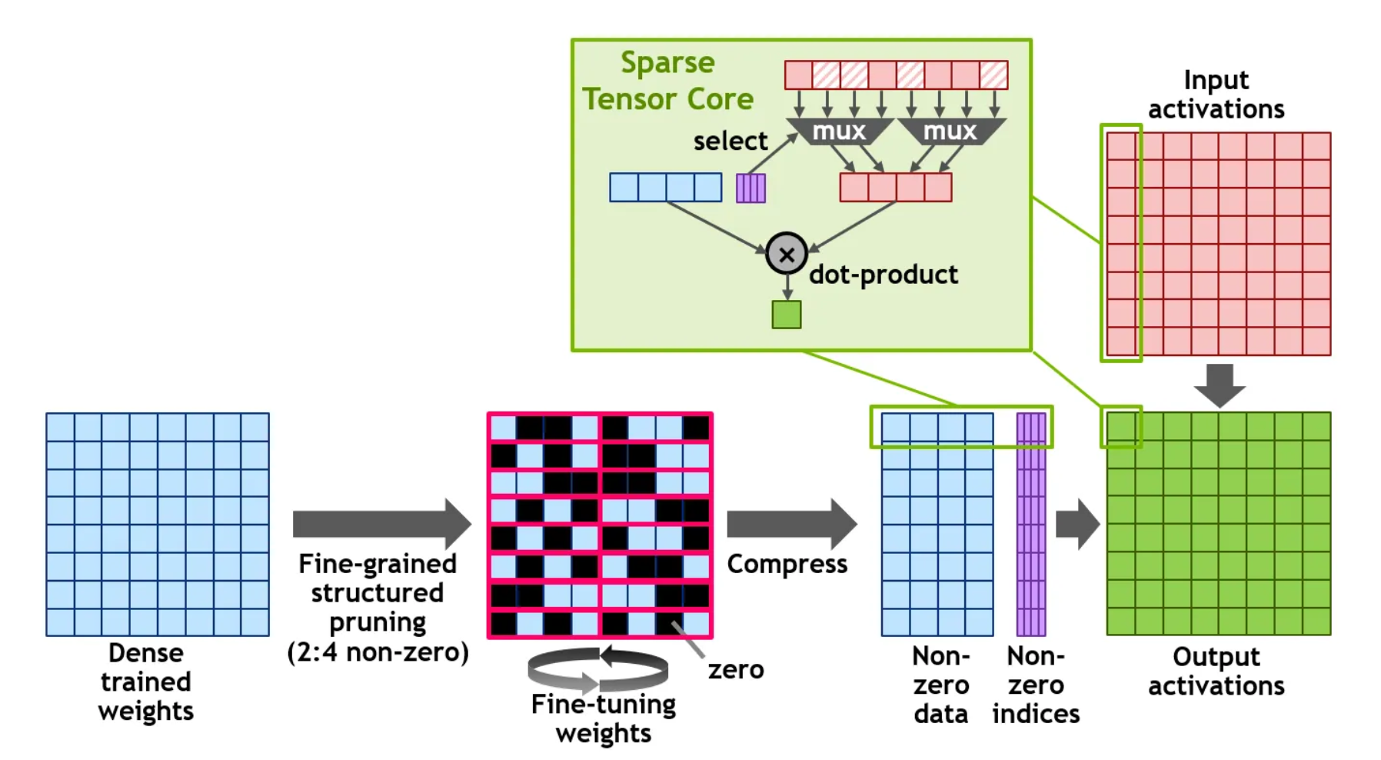

Slide 10
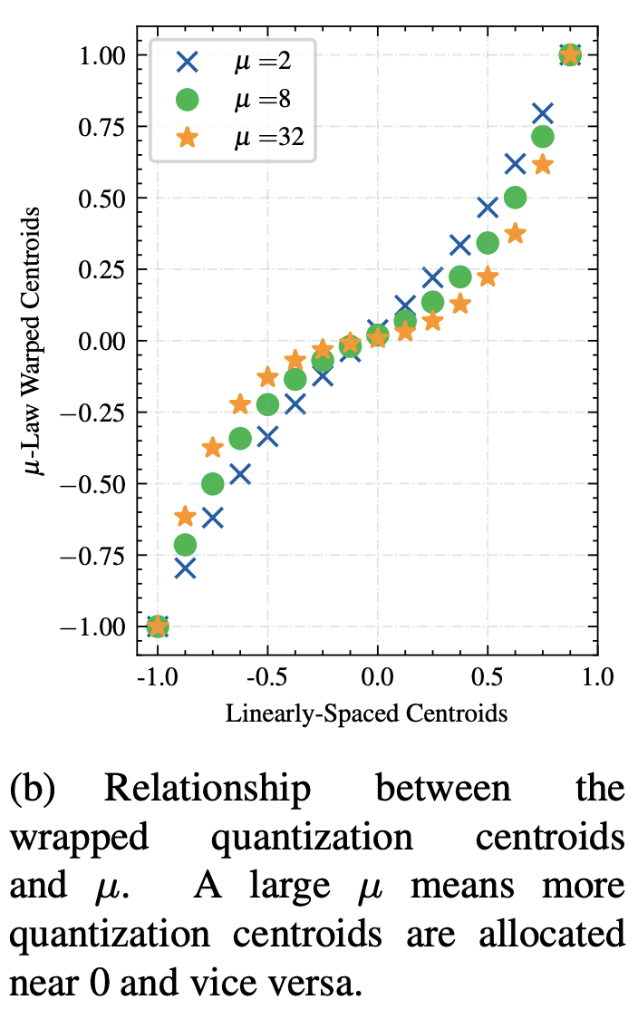

Slide 11
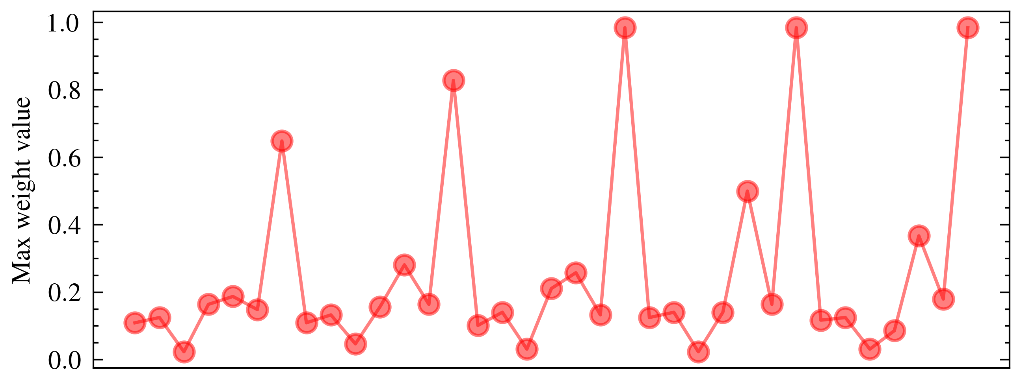
Block-1
Block-2
Block-3
Block-4
Block-5
MHA Kernels
FF Kernels
MHA Kernels
FF Kernels
MHA Kernels
FF Kernels
MHA Kernels
FF Kernels
MHA Kernels
FF Kernels

Slide 13
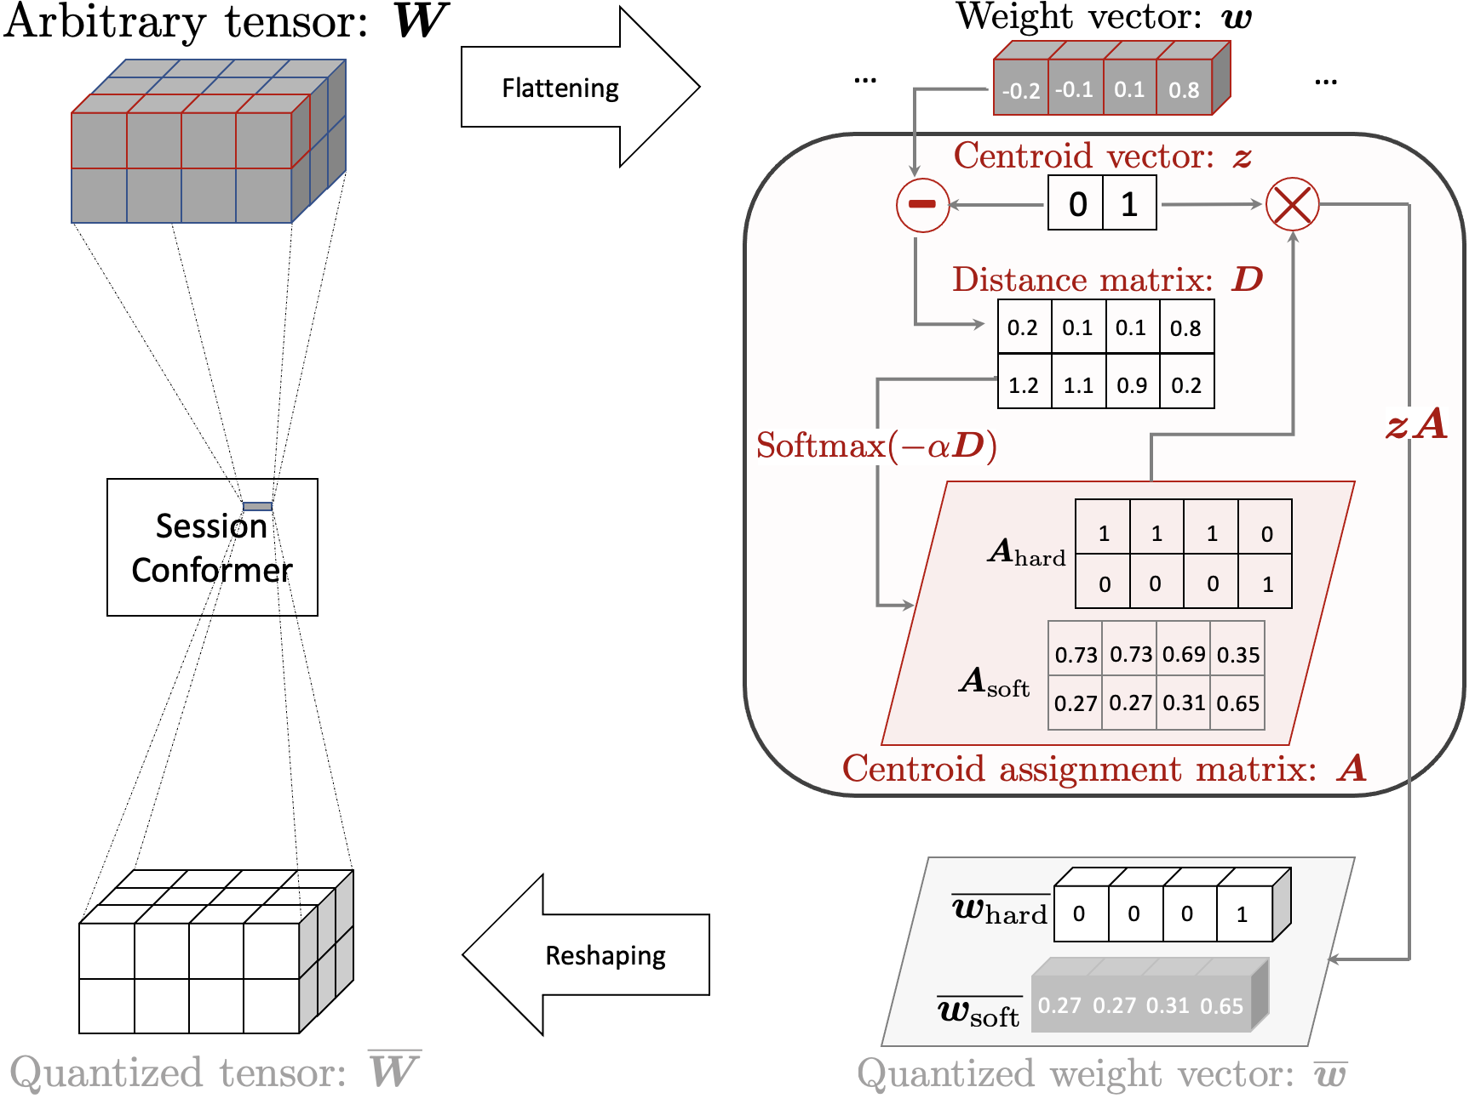
Stage-I Conformer
Session Conformer
WoQ
Neural Biasing Conformer

Slide 14
Weight histogram in FP16 format
Non-uniform 4-bit quantized weight histogram

Slide 15
Flattening
…
…
-0.2
-0.1
0.1
0.8
-
0
1
0.2
0.1
0.1
0.8
1.2
1.1
0.9
0.2
Session Conformer
1
1
1
0
0
0
0
1
0.73
0.73
0.69
0.35
0.27
0.27
0.31
0.65
Reshaping
0
0
0
1
0.27
0.27
0.31
0.65

Slide 16
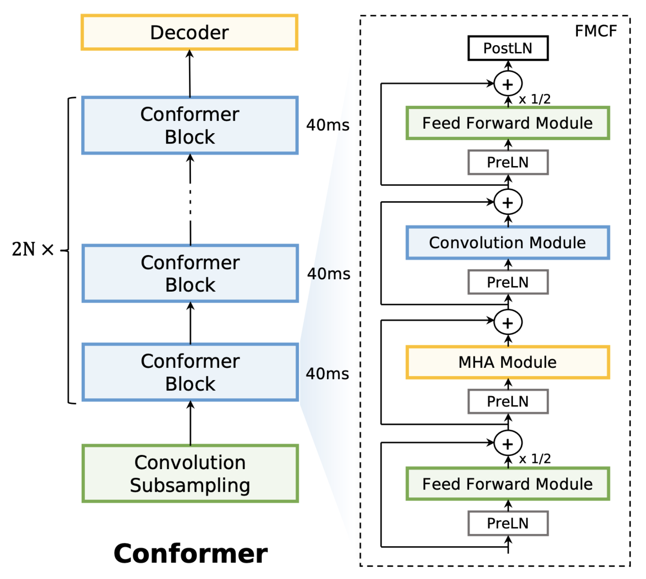
…
…
…

Slide 17
…
…
…

Slide 18
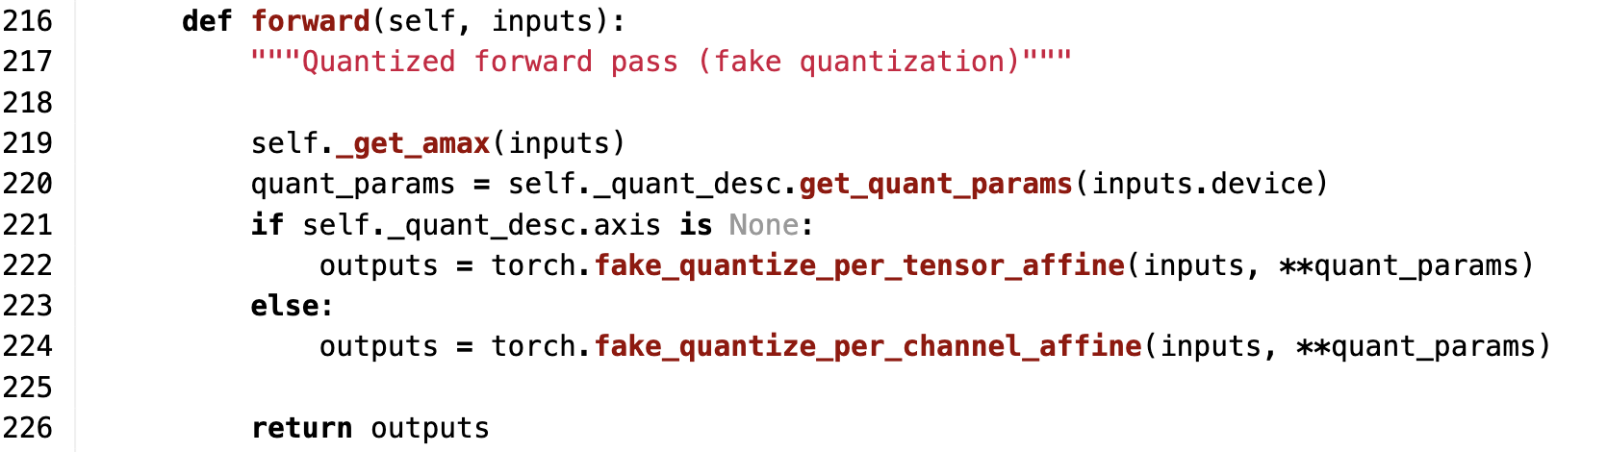

Input quantizer for S.Q.
W.o.Q

Slide 19
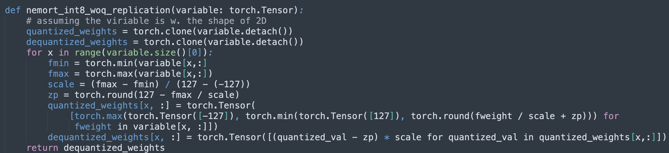

Slide 20
